Slide 1
Blood Glucose Monitoring and Treatment
Dr. Fariba Ghasemi
Pediatric Endocrinologist and Metabolism
Institute of Endocrinology and metabolism Research
Notes:
NOTE:
To change the image on this slide, select the picture and delete it. Then click the Pictures icon in the placeholder to insert your own image.

Slide 2
Blood glucose management: monitoring and treatment
Insulin:
Most children with type 1 diabetes should be treated with:
intensive insulin regimens
multiple daily injections of prandial insulin and basal insulin
continuous subcutaneous insulin infusion

Slide 3
Insulin therapy
Insulin therapy is essential for survival in all people with DM1.
The goal of insulin replacement therapy :
mimic normal physiological insulin secretion patterns.
Plasma insulin levels normally vary widely throughout the day, with low levels in the fasting and overnight periods and rapid increases in the postprandial period
Combinations of short- and long-acting insulin preparations are commonly used to replicate these patterns

Slide 4
Insulin therapy
Historically, children with type 1 diabetes were treated with:
combinations of short- and intermediate acting insulins.
The Diabetes Control and Complications Trial (DCCT), which included teenagers, demonstrated intensive insulin regimens:
achieved near normal glycemic control
reduced the risk of development and progression of complications

Slide 5
Insulin therapy
New rapid- and long acting insulin analogs with pharmacokinetic and pharmacodynamic properties that facilitate near-physiological insulin delivery are now available.
Multiple daily injection basal-bolus regimens of 1–2 injections of long-acting insulin daily with rapid-acting insulin for meals and snacks are now the standard of care.

Slide 6
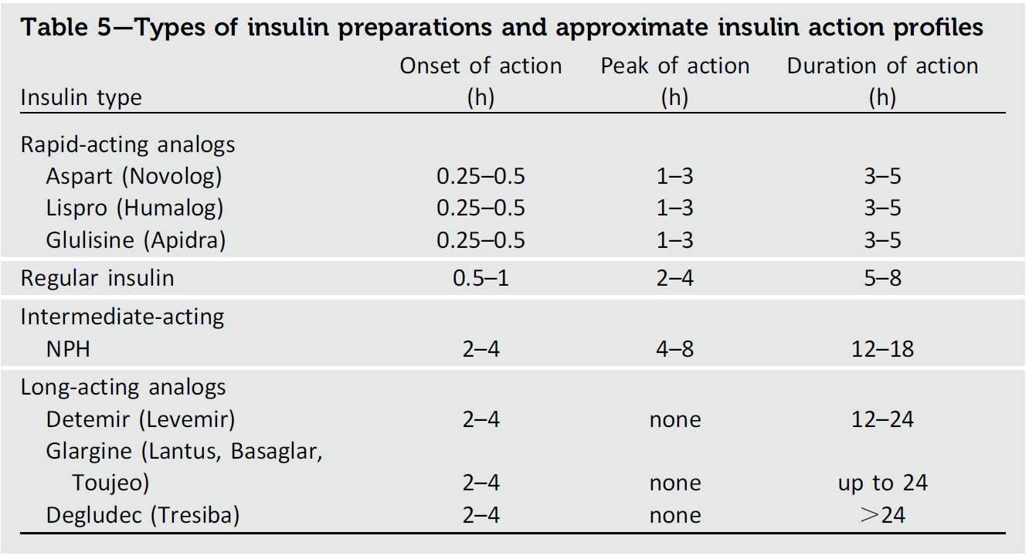

Slide 8
Insulin therapy

Slide 10
Continuous Subcutaneous Insulin Infusion
an alternative form of insulin delivery, continuous subcutaneous insulin infusion(csI) or insulin pump therapy, is often used for children DM1.
Meta-analyses of randomized controlled trials have shown modest differences between insulin pump therapy and injection regimens for improving glycemic control and reducing hypoglycemia

Slide 11
Continuous Subcutaneous Insulin Infusion

Slide 12
Continuous Subcutaneous Insulin Infusion
children treated with continuous subcutaneous insulin infusion:
lower A1C levels,
lower hypoglycemia rates,
improved diabetes related quality of life,
higher treatment satisfaction,
less fear of hypoglycemia

Slide 13
Assessment of Glycemic Control
A1C should be measured in all children and adolescents with DM1 at 3-month intervals.
A1C target of ,7.5% should be considered in children and adolescents with type 1 diabetes but should be individualized based on the needs and situation of the patient and family.

Slide 14
Assessment of Glycemic Control
The DCCT showed that the severity and duration of hyperglycemia exposure are directly related to the risk of development and progression of microvascular complications in both adults and adolescents with DM1.
To assess average glycemia over the preceding 3 months, A1C levels should be routinely measured for all individuals with DM1

Slide 15
Assessment of Glycemic Control
Historically, recommended glycemic targets for children DM1 were higher for younger children because of concern about severe hypoglycemia and its deleterious effects on cognitive development.
Recently, recommended A1C targets have been adjusted to <7.5% owing to improved tools for diabetes management and a greater understanding and recognition of the adverse effects of chronic hyperglycemia on the developing brain and a lower goal is reasonable if it can be achieved Without excessive hypoglycemia

Slide 16
Blood Glucose Monitoring
All children and adolescents with DM 1 should have blood glucose levels monitored multiple times daily (up to 6–10 times/day),
Including premeal and pre-bedtime, and as needed for safety in Specific situations such as exercise, driving, illness, or the presence of symptoms of hypoglycemia

Slide 17
Blood Glucose Monitoring
Self-monitoring of blood glucose levels (SMBG) is an essential component of treatment of DM1 in children.
Routine SMBG is necessary for determination of:
immediate insulin needs (mealtime),
assessment of safety (corrective action for or prevention of hyper- or hypoglycemia),
longer term adjustment in insulin dosing Regimens based on blood glucose patterns and trends

Slide 18
Blood Glucose Monitoring
Blood glucose should be measured :
before each meal (and snack, if using an intensive multiple daily injection or pump regimen),
before bedtime,
before (and often after) exercise,
prior to and hourly while driving (unless using CGM),
symptoms of hypoglycemia are present.

Slide 19
Blood Glucose Monitoring
Blood glucose targets should be individualized :
patient age,
Insulin regimen,
level of supervision,
lifestyle issues,
with the goal of achieving as many glucose values as close to target as possible without excessive hypoglycemia.

Slide 20
Blood/Urinary Ketone Monitoring
Routine testing of blood or urine ketones is recommended:
prolonged hyperglycemia
acute illness (fever, nausea, vomiting, abdominal pain)
insulin therapy,
prevent or reverse metabolic decompensation
determine whether referral for urgent care is required.
to guide :

Slide 21
Blood/Urinary Ketone Monitoring
The availability of blood ketone meters that measure bhydroxybutyrate in whole blood has practical and clinical Advantages:
easier sampling when urine is difficult to obtain (e.g., young children)
earlier and more accurate correlation with clinical status fasting
Morning ketosis may occur in younger children DM1 in the absence of illness or metabolic deterioration

Slide 22
Continuous Glucose Monitoring
CGM should be considered in all children and adolescents with DM1 whether using injections or insulin pump therapy, as an additional tool to help improve glycemic control.
Benefits of CGM correlate with adherence to ongoing use of the Device.

Slide 23
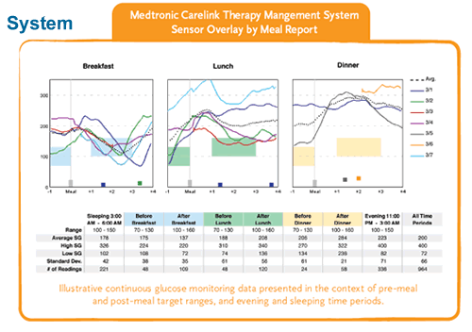
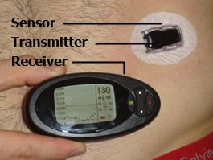
Continuous Glucose Monitoring

Slide 24
Automated Insulin Delivery
Automated insulin delivery systems appear to improve glycemic control and reduce hypoglycemia in children and should be considered in pediatric patients with DM1
The combination of continuous glucose sensors with insulin pumps:
automated insulin delivery systems (“closed-loop” or “artificial pancreas” devices).

Slide 25
Automated Insulin Delivery
insulin delivery rates based on a continuous stream of glucose sensor data. Suspending basal insulin delivery for low sensor glucose levels has: markedly reduce hypoglycemia without worsening glycemia improved glycemic control (dynamic regulation of insulin delivery for both high and low glucose levels).
“Hybrid” closed-loop systems, which modulate basal insulin delivery based on sensor glucose levels:
increased time spent within target glucose ranges,
reduced hyper- and hypoglycemia exposure,
lowered A1C levels,
improved measures of quality of life in both adult and adolescent

Slide 26
Adjunctive Therapies
There is insufficient evidence to support the routine use of adjunctive medical therapies in children DM1
Adjunctive therapies to treat DM1, primarily targeting insulin Resistance (during puberty and with obesity),have been investigated to assess potential benefit.

Slide 27
Adjunctive Therapies
However, clinical trials have failed to demonstrate a glycemic benefit of adding metformin (the only approved insulin sensitizer for use in the pediatric age range) to insulin in overweight and obese adolescents DM1
Although some studies have shown weight loss and/or reductions in insulin requirements and cardiovascular disease (CVD) risk factors with adjunctive metformin

Slide 28
Adjunctive Therapies
Pramlintide, an analog of the pancreatic polypeptide amylin,
improve glycemic control when added to insulin in adults DM1 primarily through dampening glycemic excursions by suppressing glucagon Secretion and delaying gastric emptying.
Neither pramlintide nor other potentially useful adjuncts, such as Glucagonlike peptide 1 receptor agonists (e.g.,liraglutide, exenatide) or sodium–glucose cotransporter 2 inhibitors, have been thoroughly studied in the pediatric population with DM1 and none have been approved for use in this population by the FDA.

Slide 29
Lifestyle Management
Lifestyle management is important for pediatric patients:
health maintenance,
CVD prevention,
glycemic control.
Lifestyle management includes:
approaches to nutrition and exercise.
Training patients and their families in medical nutrition therapy
approaches to mitigating both the hypo and hyperglycemic effects of exercise

Slide 30
Lifestyle Management
diabetes self-management education and support, which should be provided by a registered dietitian, a diabetes educator, an exercise Specialist/physiologist, and a pediatric endocrinologist
Extensive training should occur at diagnosis, with annual updates by the registered dietitian.
Quarterly visits with the diabetes educator and endocrinologist ensure ongoing training throughout childhood and adolescence

